Slide 1
Image Recognition using CIFAR-10 data
TEAM-2
Radhika Gathia
Shweta Tatiya
Vineeth Kashyap
Chenyang Huang
Professor Subrata Das

Slide 2
About the Dataset:
What is CIFAR-10?
The CIFAR-10 dataset consists of 60,000 32X32 images which are divided into 10 categories (airplane, automobile, bird, cat, etc.) and each category has 6000 images. The images are split in train and test.
Train- 50,000 observations
Test- 10,000 observations
Library used for processing CIFAR-10 dataset:
Keras is a high-level neural networks API, which runs on Python and uses TensorFlow in the background. It allows for fast prototyping.

Slide 3
Convolution Neural Network:
CNNs are one of the most commonly used Neural Networks for Image Classification and Recognition. This is the technique that we are going to use on the CIFAR-10 dataset to classify images in one of the 10 categories.
CNN has 4 steps:
Convolution
Activation Function
Pooling
Fully Connected Layer - Dense Layer

Slide 4
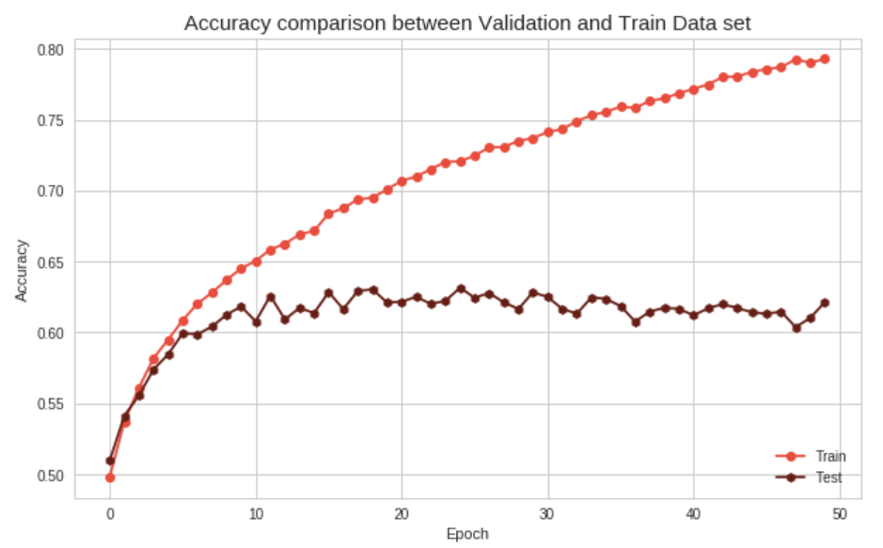
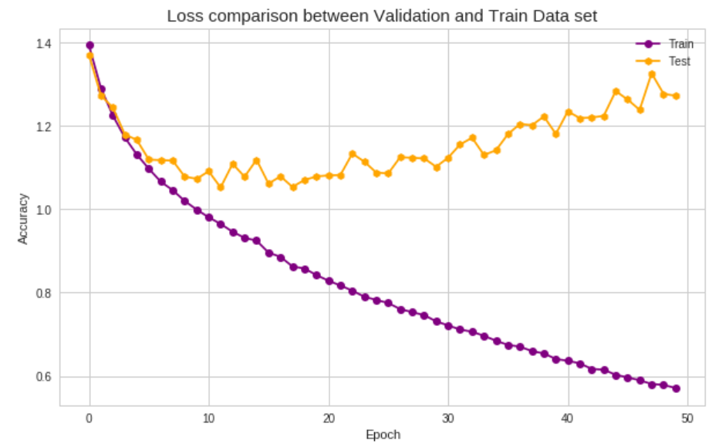
Model 1:
Parameters Used :
Number of convolution layers: 5
Number of pooling layers: 1
Number of dropout layers: 1
Activation Function: tanh
Optimizer: Adamax
Kernel Initialization:
random-normal
Epochs-50
Batch-size : 32
Accuracy: 79.72%
Validation Accuracy: 62.14%
Loss:0.579
Validation Loss:0.6214

Slide 5
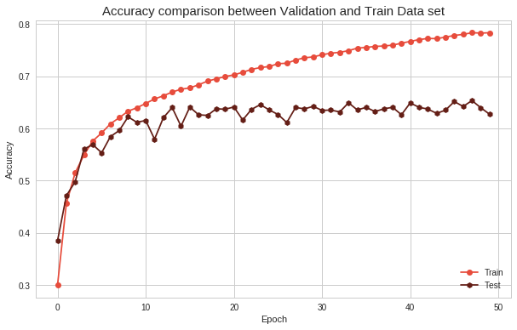
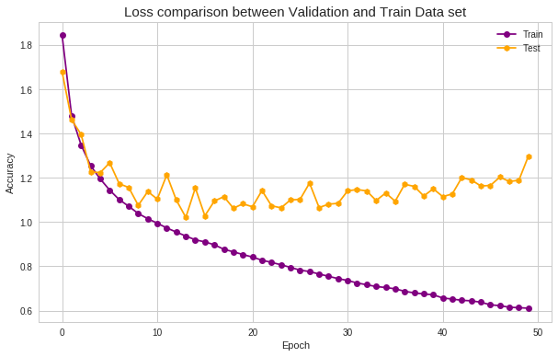
Model 2:
Parameters Used :
Number of convolution layers: 5
Number of pooling layers: 1
Number of dropout layers: 1
Activation Function: reLu
Optimizer: RMSProp
Kernel Initialization:
random_normal
Epochs-50
Batch-size : 500
Accuracy: 78.36%
Validation Accuracy:62.73%
Loss:0.6106
Validation Loss:1.2982

Slide 6
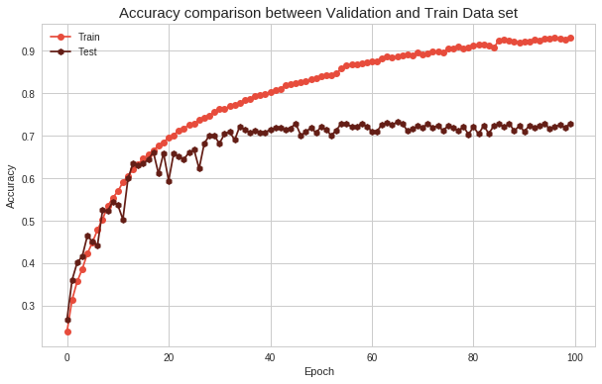
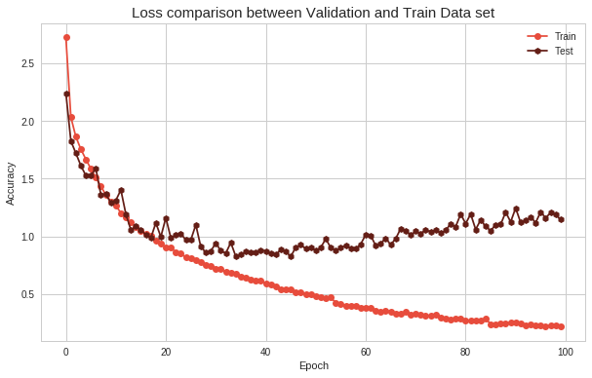
Model 3:
Parameters Used :
Number of convolution layers: 8
Number of pooling layers: 1
Number of dropout layers: 1
Activation Function: reLU
Optimizer: Adamax
Kernel Initialization:
glorot_uniform
Epochs-100
Batch-size : 500
Accuracy: 93.01%
Validation Accuracy: 72.93%
Loss:0.2222
Validation Loss:1.1419

Slide 7
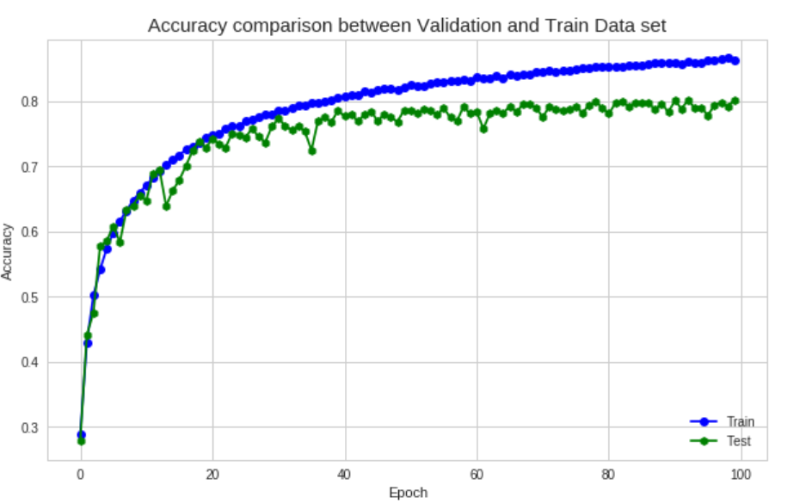
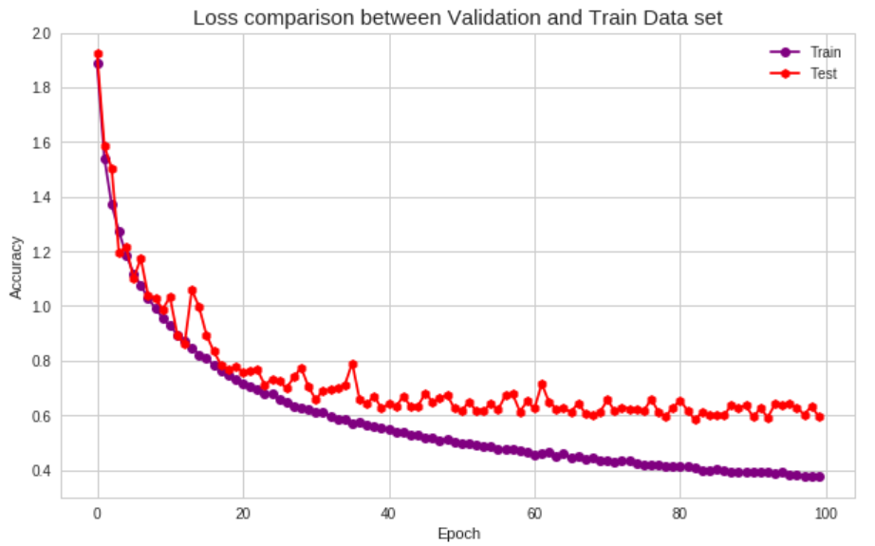
Model 4:
Parameters Used :
Number of convolution layers: 7
Number of pooling layers: 3
Number of dropout layers: 3
Activation Function: reLu
Optimizer: Adamax
Kernel Initialization:
uniform
Epochs-100
Batch-size : 500
Accuracy: 86.33%
Validation Accuracy: 80.17%
Loss:0.376
Validation Loss:0.8017

Slide 8
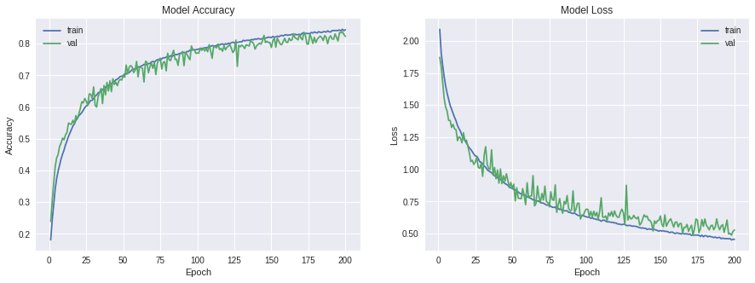
Model 5 :
Parameters Used :
Number of convolution layers: 15
Number of pooling layers: 3
Number of dropout layers: 4
Activation Function: relu
Optimizer: Adam
Kernel Initialization:
glorot_uniform
Epochs-200
Batch-size : 100
Accuracy: 84.43%
Val_Acc : 82.30%
Loss: 0.1960
Validation-Loss:0.452

Slide 9
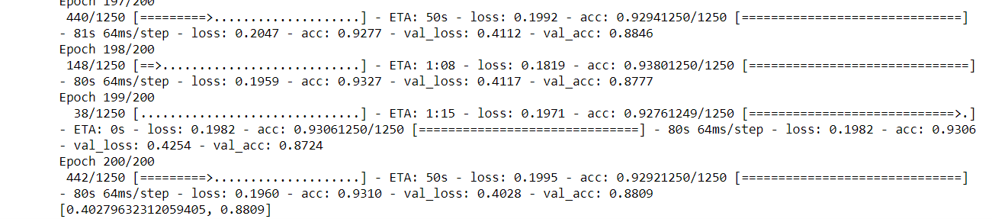
Model 6:
Parameters Used :
Number of convolution layers: 10
Number of pooling layers: 2
Number of dropout layers:3
Activation Function: relu
Optimizer: Adam
Kernel Initialization:
glorot_uniform
Epochs-200
Batch-size : 32
Accuracy: 93%
Validation Accuracy : 88.09%
Loss: 0.1960
Validation Loss: 0.4028

Slide 10
Parameters/Hyperparameters Tuning:
Activation Functions: sigmoid, tanh, ReLu, LeakyReLu
Kernel Initialization: random-normal, glorot-uniform
Epochs: The number of iterations.
Batch Size:
Optimizer: SGD, Adamax, Adam, RMSProp
Loss: binary-crossentropy, categorical-crossentropy, sparse categorical crossentropy
Dropout: A regularization layer

Slide 11
Optimizers:
Adam- It is one of the fastest optimization algorithm, it computes an individual learning rate per parameter.
RMSProp - Maintains a per parameter learning rate and does well on cases where the data is noisy.
Adamax - A form of Adam optimizer which works well on a sparse dataset.
SGD - Stochastic Gradient Descent forms the basis of all the algorithms, but since it does not do adaptive initialization like Adam, it is considerably slow.

Slide 12
Batch Normalization :
Batch normalization could benefit the learning of our model in two ways: faster learning and higher overall accuracy.
From model 1 to model 2 we found that the learning is much more faster
As the data flows through a deep network, the weights and parameters adjust its values, sometimes making the data too big or too small again - a problem called "internal covariate shift". By normalizing the data in each mini-batch, this problem is largely avoided.

Slide 13
Data augmentation:
Data augmentation means increasing the number of data points. For images, it means that increasing the number of images in the dataset.
How can we do it ?
We can simply rotate the image or change the brightness or saturation of the model.
Why we are doing it？
It help us prevent overfitting. As the data are generalized by flipping and rotating.

Slide 14
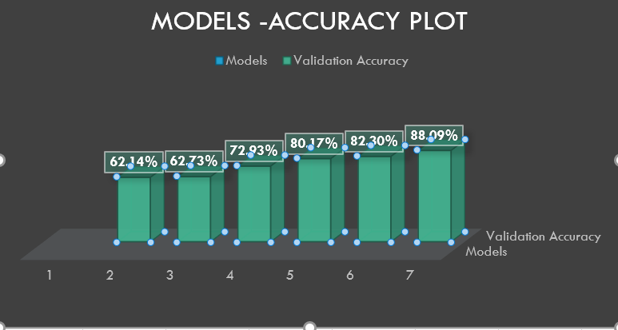
Results:
Model | Accuracy | Validation Accuracy | Loss | Validation Loss
Model 1 | 79.72% | 62.14% | 0.57 | 0.6214
Model 2 | 78.36% | 62.73% | 0.610 | 1.2982
Model 3 | 93.01% | 72.93% | 0.22 | 1.1419
Model 4 | 86.33% | 80.17% | 0.37 | 0.8017
Model 5 | 84.43% | 82.30% | 0.196 | 0.452
Model 6 | 93% | 88.09% | 0.196 | 0.4028

Slide 15
Thank You!

